Slide 1
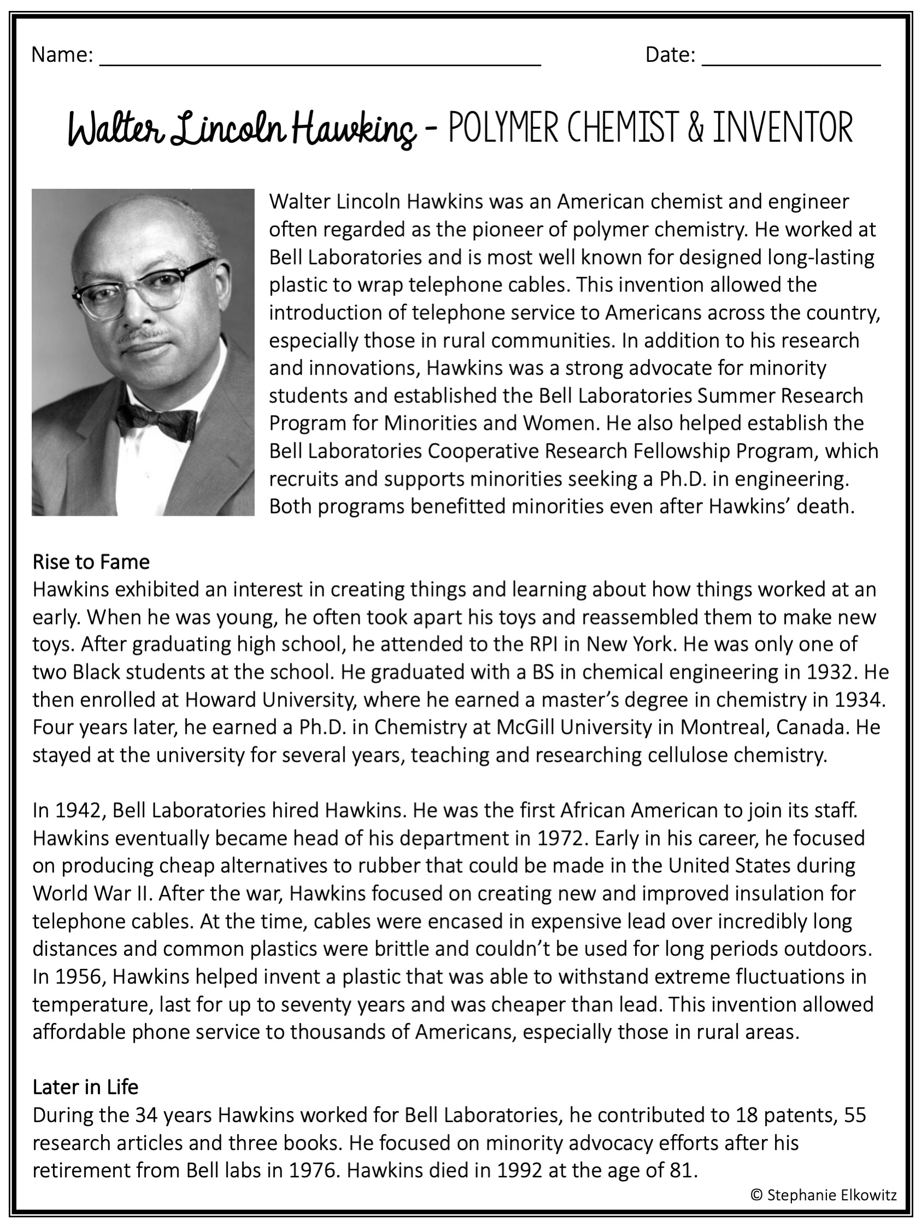

Slide 2
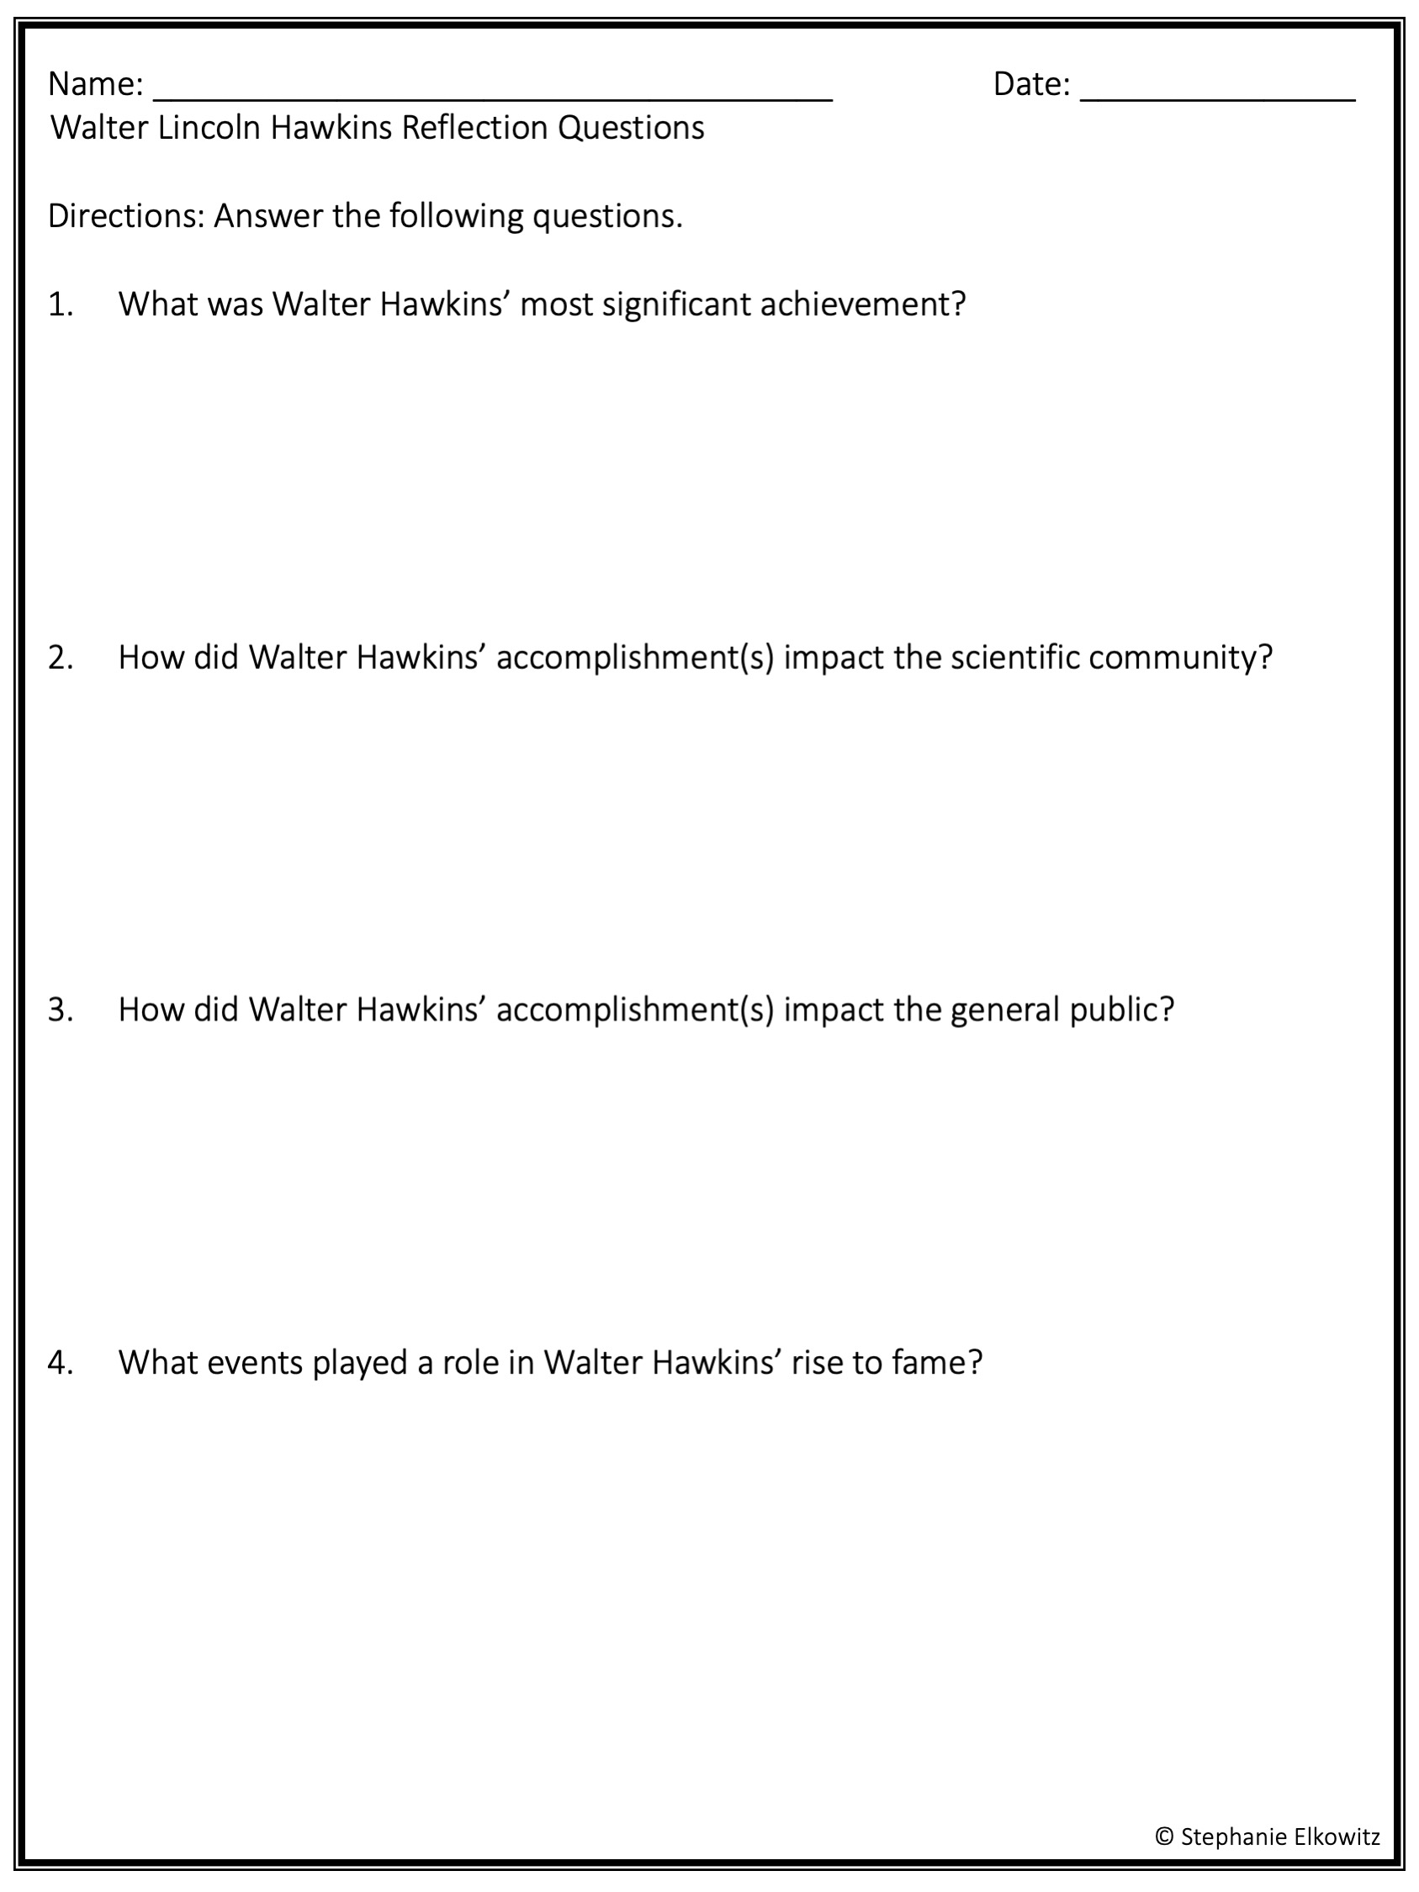
Write your answer here.
Write your answer here.
Write your answer here.
Write your answer here.

